Slide 1
VIDEO GAME SALES ANALYSIS

Slide 2
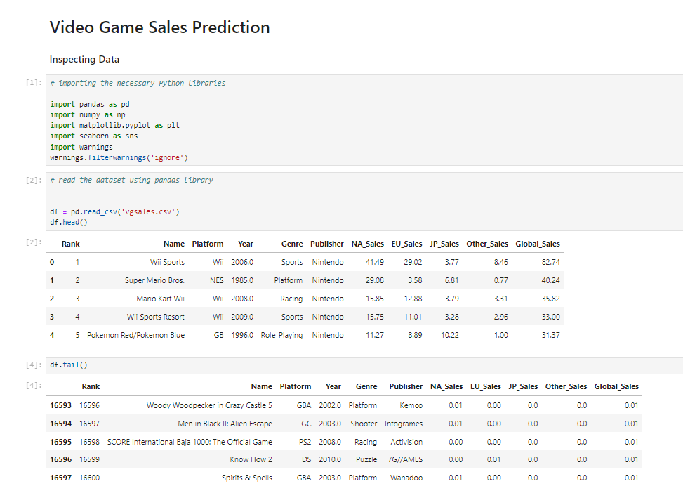
This Code block imports the necessary Python libraries that are commonly used for data analysis, visualization, and suppressing warnings.
In the second cell the code is allowing to read a dataset from a CSV file using the pandas library and display the first few rows of the dataset:

Slide 3
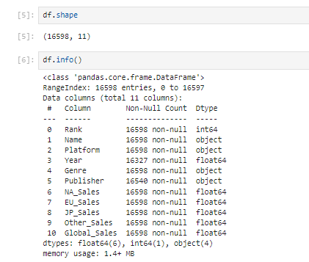
In this code snippet, two pandas functions are being used: df.shape and df.info(). They provide essential information about the structure of the DataFrame.
df.shape returns the dimensions of the DataFrame, showing the number of rows and columns.
df.info() provides a concise summary of the DataFrame, including the column names, data types, non-null values, and memory usage

Slide 4
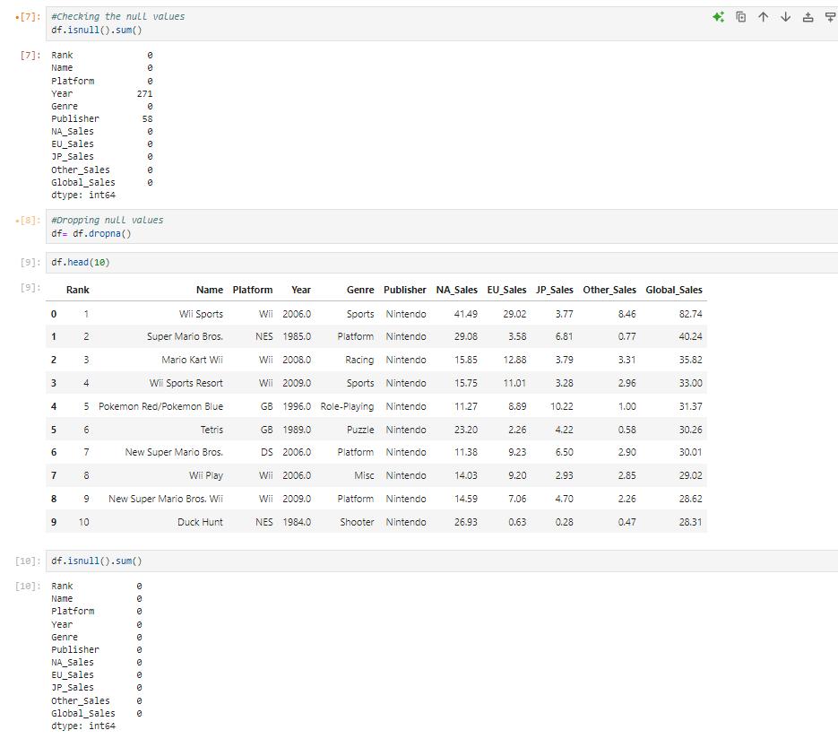
df.isnull().sum(): Helps you identify how many missing values exist in each column.
df.dropna(): Drops rows that contain any missing values, cleaning the dataset at the cost of potentially removing valuable data.

Slide 5
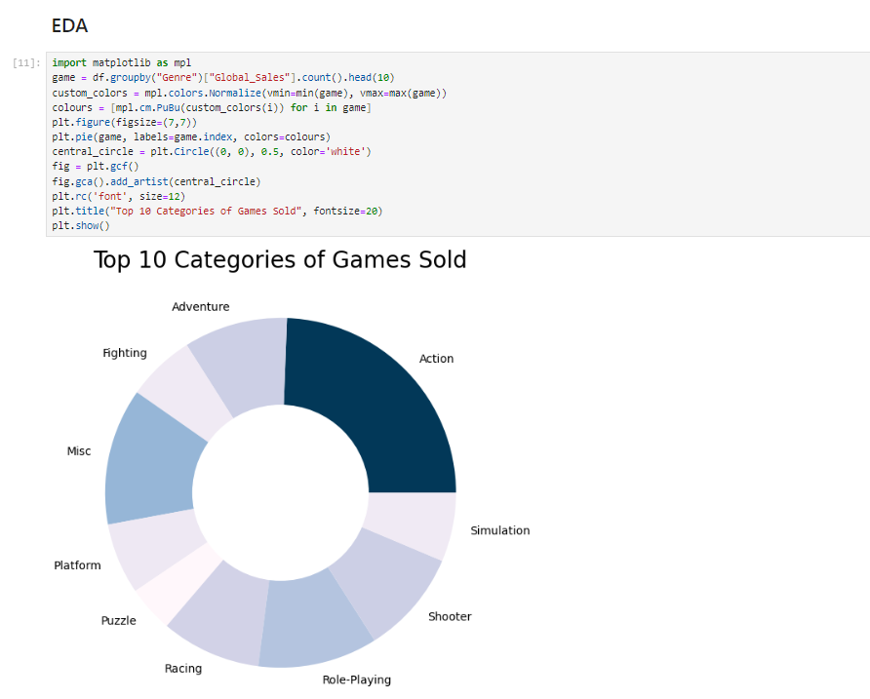
This code effectively visualizes the distribution of video game sales by genre using a pie chart. The normalization and custom coloring enhance the visualization's aesthetics. The central circle transforms the pie chart into a donut chart, which can be visually appealing and easier to interpret in some contexts. Overall, this approach provides a clear insight into which genres have the most global sales.

Slide 6
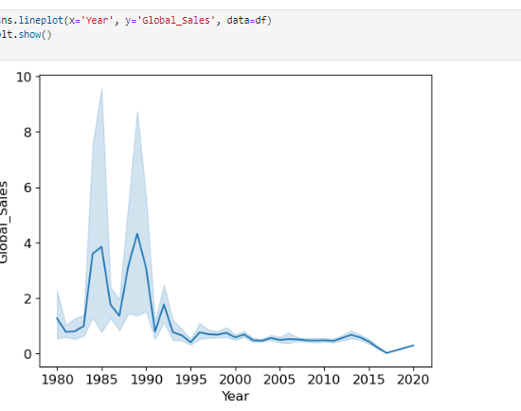
This code snippet visualizes the trend of global video game sales over the years using a line plot. It provides a clear and effective way to observe how sales figures have evolved, allowing for insights into the video game market's growth or decline over time.

Slide 7
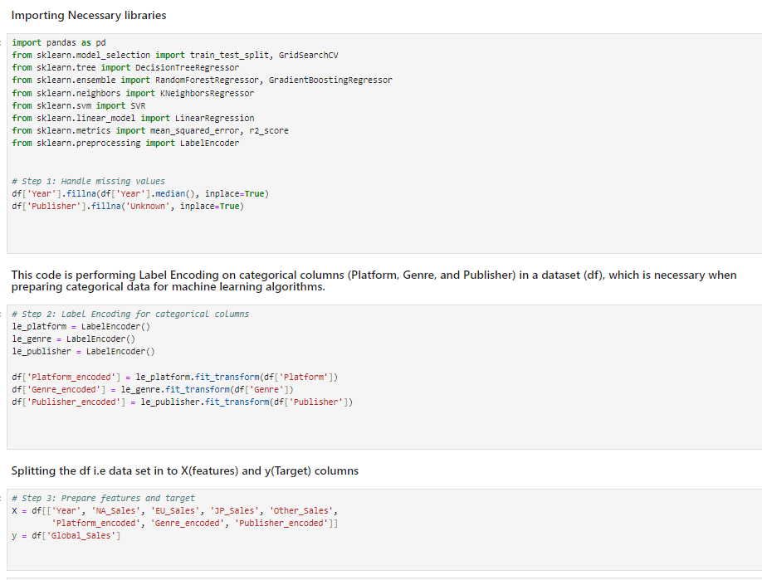
Missing Values: The code handles missing values by filling the Year with its median and the Publisher with 'Unknown’.
Encoding: Categorical variables are encoded into numerical format using LabelEncoder, allowing them to be used in machine learning models.
Feature and Target Preparation: The features (independent variables) and the target variable (dependent variable) are defined for modeling, setting the stage for subsequent analysis or machine learning processes.
This preprocessing pipeline is essential for preparing the dataset for any machine learning tasks, ensuring that the data is clean and appropriately formatted for model training.

Slide 8
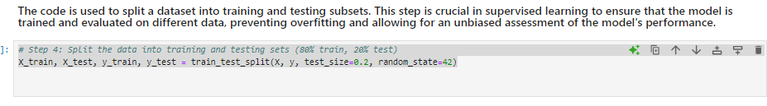
The dataset is split into training (80%) and testing (20%) subsets.The training set is used to fit the machine learning model, and the testing set is used to evaluate the model's performance on unseen data.The random_state ensures that the split is consistent and reproducible across multiple runs, which is important for reproducibility in machine learning experiments.

Slide 9
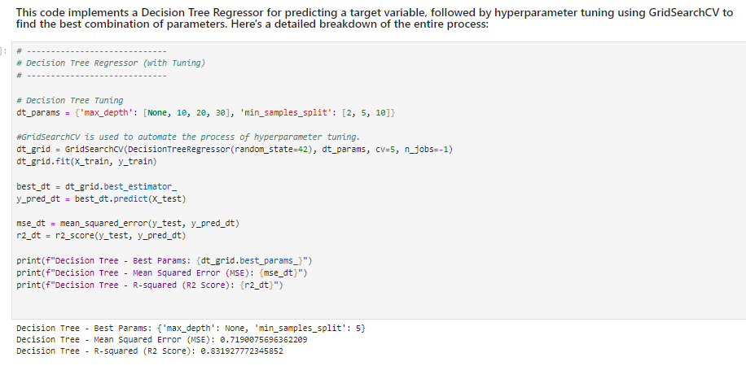
Code trains and evaluates a Decision Tree Regressor model using GridSearchCV to find the optimal hyperparameters for the model.
Step 1: A grid of hyperparameters (max_depth and min_samples_split) is defined for the Decision Tree Regressor.
Step 2: GridSearchCV is used to train and evaluate different models with combinations of the defined hyperparameters, using 5-fold cross-validation.
Step 3: The best model is selected based on cross-validation results, and this model is used to predict the target values on the test set.
Step 4: The model is evaluated using Mean Squared Error (MSE) and R-squared (R² Score) to assess its accuracy and performance.This process helps in selecting the most effective hyperparameters for the Decision Tree model, improving the model's prediction accuracy on unseen data.

Slide 10
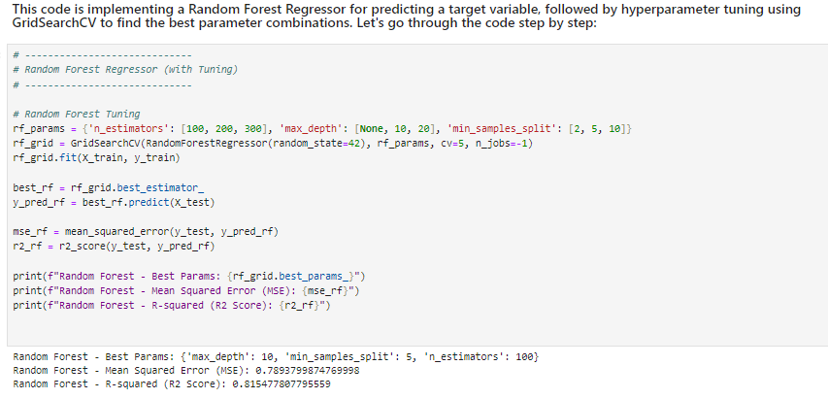
This code is designed to train and evaluate a Random Forest Regressor using GridSearchCV to find the optimal hyperparameters for the model.
1.Hyperparameter Tuning: A grid of hyperparameters (n_estimators, max_depth, and min_samples_split) is defined to tune the Random Forest Regressor.
2.GridSearchCV: Performs an exhaustive search over different combinations of hyperparameters using cross-validation.
3.Best Model: After searching, the model with the best hyperparameters is selected, and predictions are made on the test data.
4.Evaluation: The model is evaluated using Mean Squared Error (MSE) and R-squared (R² Score), which help determine how well the model is performing.
This process aims to find the most effective hyperparameters for the Random Forest Regressor, improving its ability to predict unseen data with higher accuracy.

Slide 11
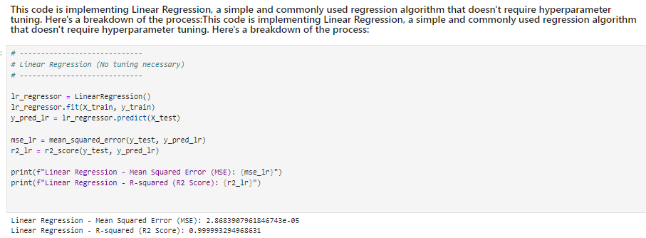
This code trains and evaluates a Linear Regression model on the dataset. Since linear regression has no significant hyperparameters to tune, it is straightforward compared to other models like Decision Trees or Random Forests.
1.Model Initialization: A Linear Regression model is created with no additional hyperparameters.
2.Model Training: The model is trained on the training data (X_train and y_train).
3.Prediction: The model is used to make predictions on the test set (X_test).
4.Evaluation: The model is evaluated using Mean Squared Error (MSE) and R-squared (R² Score) to assess its performance.MSE indicates how far the predicted values are from the actual values.R² Score shows how well the model explains the variance in the dataset.
Linear Regression is typically a simple and efficient model, making it ideal for initial exploration and comparison with more complex models

Slide 12
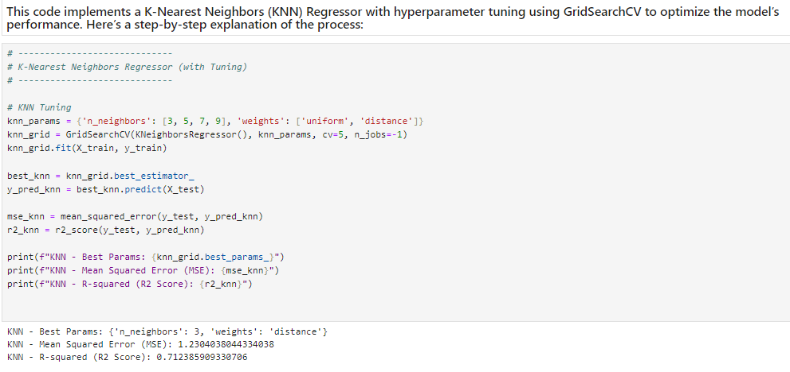
This code trains and evaluates a K-Nearest Neighbors (KNN) Regressor using GridSearchCV to tune the model’s hyperparameters and find the best configuration for prediction.
1.Hyperparameter Tuning: The grid search tunes two hyperparameters:n_neighbors (number of nearest neighbors) andweights (how the distance of neighbors affects predictions).
2.Model Training: The best KNN model is selected based on cross-validation performance.
3.Prediction: The model makes predictions on the test set (X_test).
4.Evaluation: The model’s performance is evaluated using Mean Squared Error (MSE) and R-squared (R² Score), which help assess how well the model predicts the target values.
The KNN Regressor is a simple, instance-based learning algorithm that predicts values based on the distance between data points. This process helps optimize the number of neighbors and distance weighting to improve prediction accuracy.

Slide 13
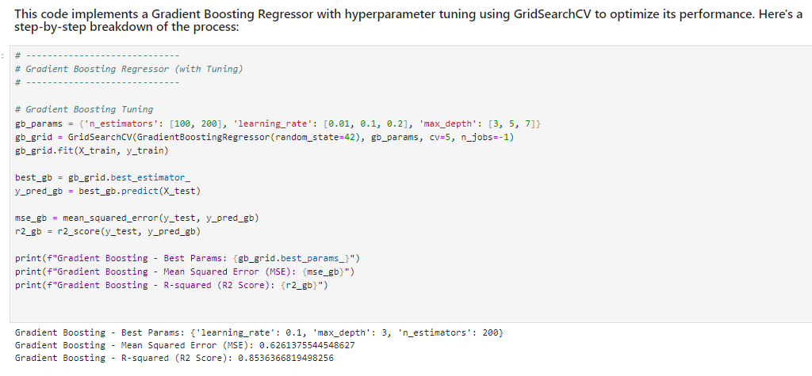
This code trains and evaluates a Gradient Boosting Regressor using GridSearchCV to find the optimal hyperparameters for the model, optimizing its performance for predicting the target variable.
1.Hyperparameter Tuning: The grid search tunes three hyperparameters:n_estimators (number of trees),learning_rate (how much each tree contributes), andmax_depth (complexity of individual trees).
2.Model Training: The best gradient boosting model is selected based on cross-validation performance.
3.Prediction: The model makes predictions on the test set (X_test).
4.Evaluation: The model’s performance is evaluated using Mean Squared Error (MSE) and R-squared (R² Score), which help assess how well the model predicts the target values.
Gradient Boosting is a powerful ensemble learning technique that builds trees sequentially, where each tree corrects the errors of the previous one, making it well-suited for regression tasks where high accuracy is needed.

Slide 14
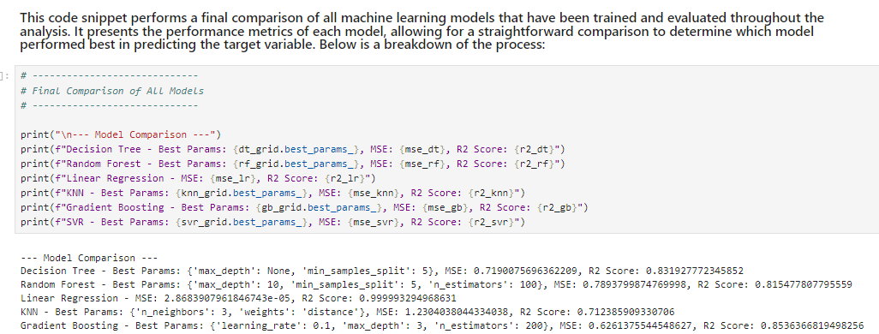
This code compares the performance of all the models trained earlier, displaying their best hyperparameters (if applicable) and evaluation metrics, including Mean Squared Error (MSE) and R-squared (R² Score). This helps to assess which model performed the best on the test data.
1.Decision Tree: Tuned based on max_depth and min_samples_split.
2.Random Forest: Likely to perform better than the decision tree due to ensembling multiple trees.
3.Linear Regression: A baseline model for comparison, usually outperformed by more complex models.
4.KNN: Predictive accuracy depends heavily on the number of neighbors (n_neighbors) and the distance weighting (weights).
5.Gradient Boosting: A powerful model that builds sequential trees, often yielding very accurate results when tuned properly.
This comparison helps you identify the model that best suits your dataset based on error rates and variance explanations.

Slide 15
THANKYOU

